Slide 1
Autonomous Cars

Slide 2
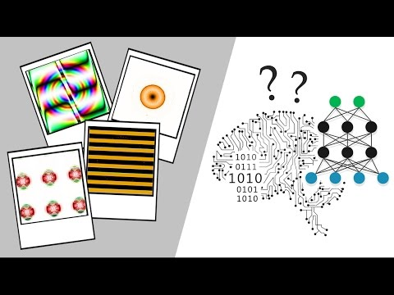
Adding Noise to Images

Slide 3
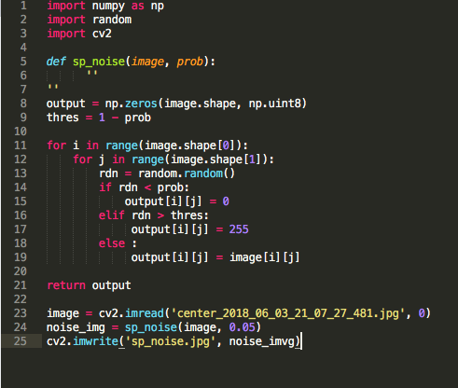
Code for adding noise

Slide 4
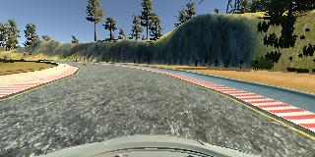
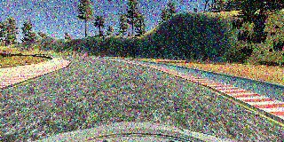
Normal vs. Noisy

Slide 5
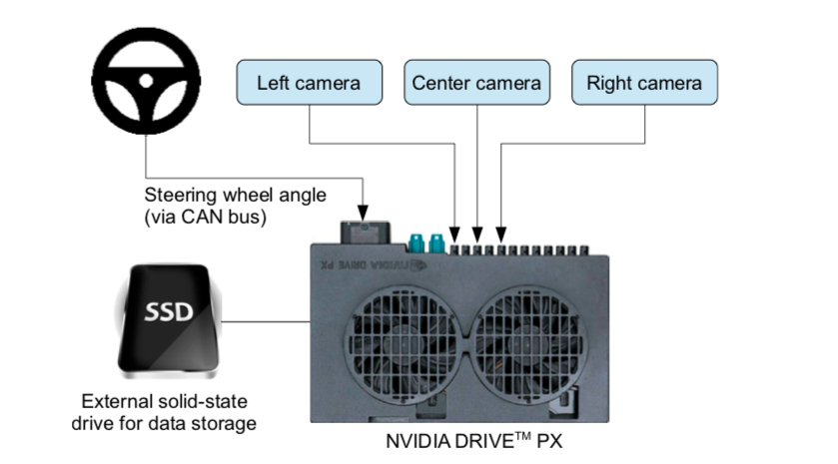
Results

Slide 6
Results
1000 images per camera (center, left, right)
the adversarial samples varied between 5 and 10 items
the training was performed on 10 epochs
the autonomous mode couldn’t be turned on

Slide 7
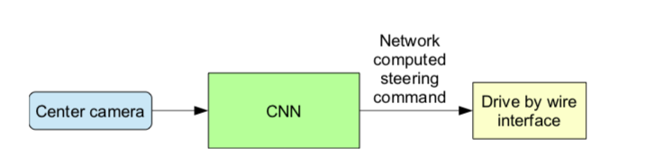

Slide 8
Future Work
Find ways to make the autonomous mode work
Quantify the how the perturbations affect the autonomous mode
Implement other cyber attacks (code injection)

